Slide 1
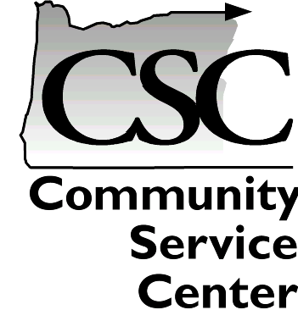
Welcome!
2015 Douglas County NHMP
Update Training Meeting

Slide 2
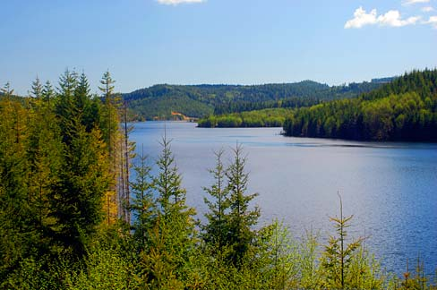
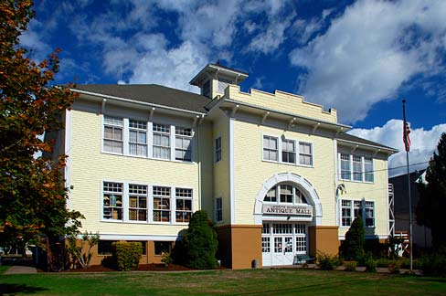
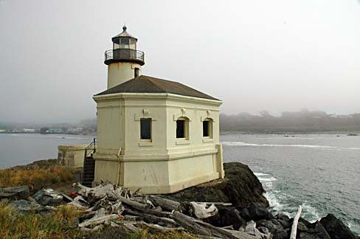
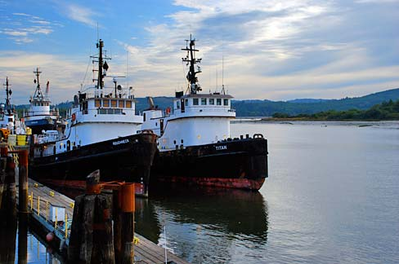
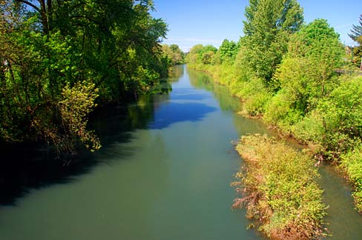
Introductions
Name
Organization
Hopes and/or Expectations

Slide 3
What is the Community Service Center?
The Community Service Center assists Oregon communities by providing planning and technical assistance to help solve local issues and improve the quality of life for Oregon residents.
CSC provides four service learning programs:
Resource Assistance for Rural Environments
Economic Development Administration Center
Community Planning Workshop
Oregon Partnership for Disaster Resilience
Notes:
The Community Service Center (CSC) links the energy, expertise and innovation of the University of Oregon
with the planning and public policy needs of Oregon communities.
The CSC is an interdisciplinary organization that creates learning opportunities for students by providing planning and technical services to Oregon Communities

Slide 4
Oregon Partnership for Disaster Resilience
OPDR coordinates limited resources to generate activity that could not be accomplished by any one group or organization working alone.
The Approach:
Integrated
Cost-effective
Systematic
Notes:
General explanation of OPDR’s function al role
Also use the diagram to explain OPDR’s location on campus / Community Service Center / implications & opportunities
(Josh... We don’t have logo with better resolution (really). The new one looks fuzzy, so I’ve just left this without alteration).

Slide 5
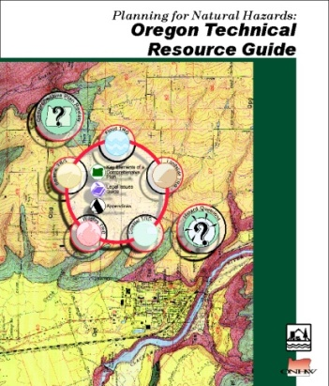
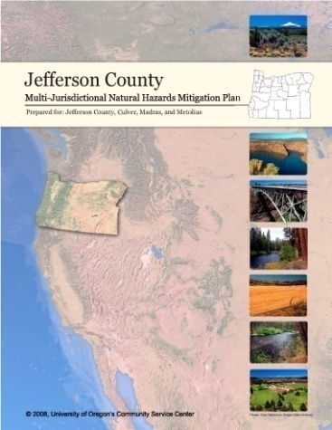
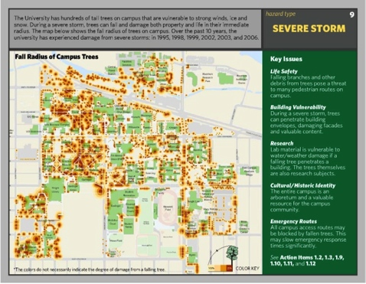
OPDR Initiatives
Post-Disaster Recovery Planning for Catastrophic Disasters
Resilient Communities
Technical Resource Development and Research
Local & Statewide Pre-Disaster Mitigation Planning
Notes:
Main activities
PDM; Recovery; Campus; Technical Resource Development & Research. PDM is bolded because we’ll be talking mostly about activities within this program area today. Preps for a broader introduction to OPDR’s activities throughout the state (past / present / future)

Slide 6
Training Goals & Objectives
Explain natural hazard mitigation
Review the benefits of developing a natural hazard mitigation plan
Provide an overview of the planning process

Slide 7
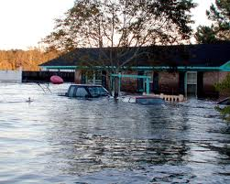
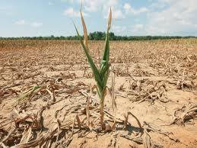
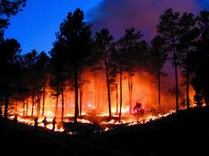
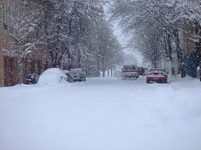
Natural Hazards

Slide 8
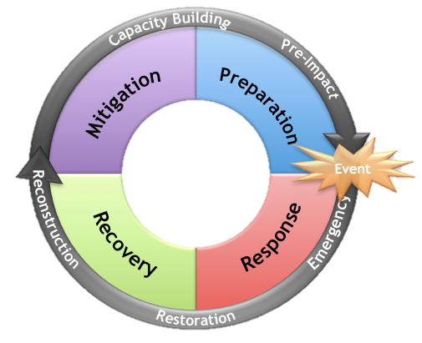
The Disaster Cycle

Slide 9
Hazard, Vulnerability & Disaster

Slide 10
Mitigation
Hazard Mitigation Planning: Act Before Disaster Strikes
Mitigation: any sustained action taken to reduce or eliminate long-term risk to life and property from a hazard event
Strategies: Policy Changes, Education and Outreach, Capital Projects

Slide 11
Community Partnerships
Emergency Management
County/City Staff
General Public
Elected bodies
Utility Companies
Others?

Slide 12
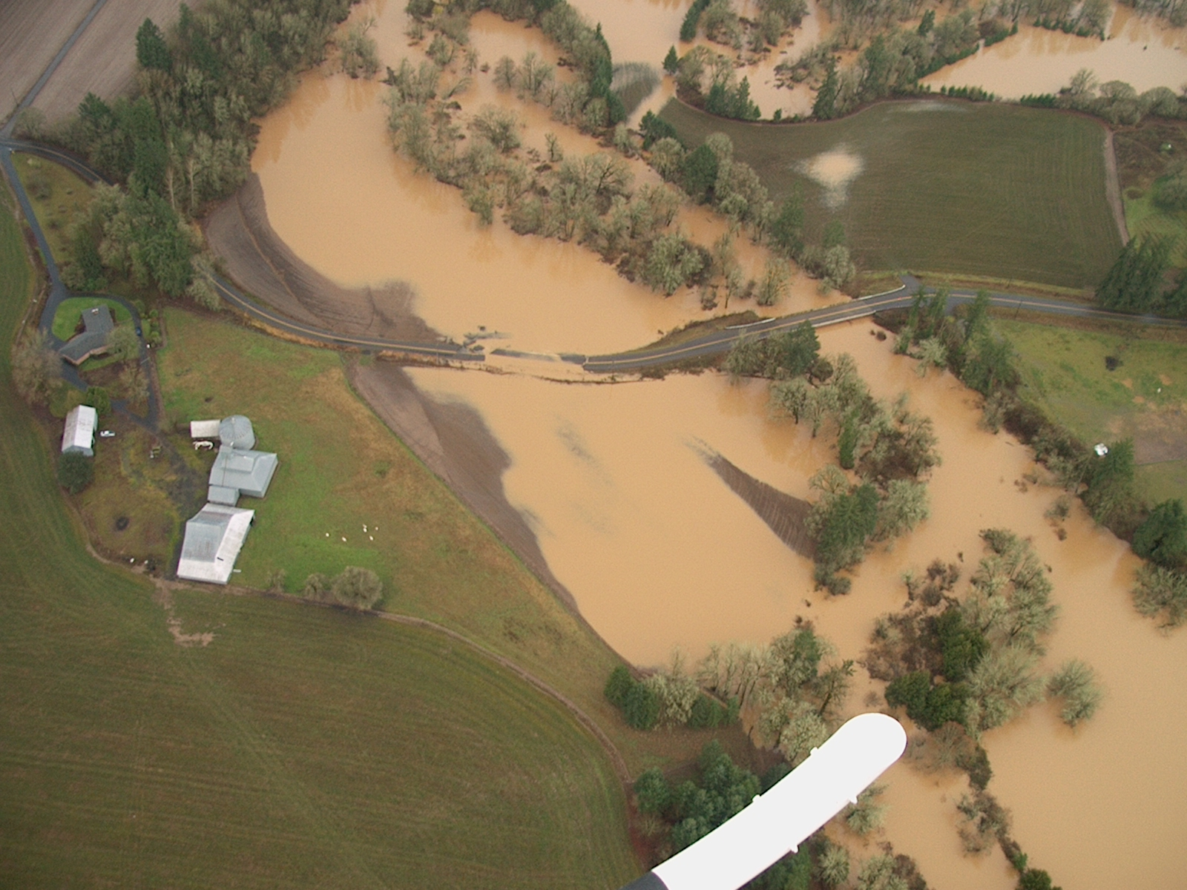
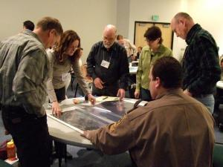
Mitigation planning opportunities
Awareness of risks, sensitivities, and vulnerabilities
Reduce hazard impact
Save lives, property and money
New community partnerships
Create more resilient communities
Mitigation becomes a part of ordinary government business
Support rapid recovery
Receive federal funding
Poverty Bend Road, December 2012 Flood
Source: OregonLive

Slide 13
Plan Elements

Slide 14
NHMP Plan Elements
Natural Hazards Profile
Community Profile
Risk Assessment
Policy Crosswalk
Action Items
Natural Hazards Mitigation Plan

Slide 15
Step 1: Community Profile Update
Natural Hazards Profile
Community Profile
Local geography
Climate
Population characteristics
Employment
Economics
Housing
Transportation
Infrastructure
Cultural resources
Government structure
Risk Assessment
Policy Crosswalk
Action Items
Natural Hazards Mitigation Plan

Slide 16
Step 2: Natural Hazards Profile
Natural Hazards Profile
Community Profile
Update hazard history
Review 2010 hazard profiles
Update hazard maps
Hazard ID Plan Update Requirements
Description of the hazard
ID the location
ID extent of hazard
Provide information on previous occurrences and probability of future occurrences
Risk Assessment
Policy Crosswalk
Action Items
Natural Hazards Mitigation Plan

Slide 17
Step 3: Risk assessment
Natural Hazards Profile
Community Profile
Risk Assessment: Identifies natural hazards and the community’s vulnerability to inform the mitigation strategy
Risk Assessment
Policy Crosswalk
Action Items
Multi-jurisdictional Risk Assessment - §201.6(c)(2) (iii): For multi-jurisdictional plans, the risk assessment must assess each jurisdiction’s risks where they vary from the risks facing the entire planning area.
Natural Hazards Mitigation Plan

Slide 18
Step 4: Policy Crosswalk
Identifies elements of existing plans and policies that may support mitigation strategies
Example plans:
Comprehensive plan
Capital improvement plan
Community wildfire protection plan
Parks and open space plan
Floodplain ordinances
Emergency operations plan
Stormwater mgmt plan
Natural Hazards Profile
Community Profile
Risk Assessment
Policy Crosswalk
Action Items
Natural Hazards Mitigation Plan

Slide 19
Step 5: Mitigation Strategy
Community guide to address vulnerabilities and risks
Action items
Natural Hazards Profile
Community Profile
Risk Assessment
Multi-jurisdictional Mitigation Strategy - §201.6(c)(3) (iv): For multi-jurisdictional plans, there must be identifiable action items specific to the jurisdiction requesting FEMA approval or credit of the plan.
Policy Crosswalk
Action Items
Natural Hazards Mitigation Plan

Slide 20
Step 6: Updated NHMP
Natural Hazards Profile
Community Profile
Multi-jurisdictional Participation - §201.6(a)(3) Multi-jurisdictional plans (e.g., watershed plans) may be accepted, as appropriate, as long as each jurisdiction has participated in the process
Risk Assessment
Policy Crosswalk
Action Items
Multi-jurisdictional Plan Adoption - §201.6(c)(5) For multi- jurisdictional plans, each jurisdiction requesting approval of the plan must document that it has been formally adopted.
Natural Hazards Mitigation Plan

Slide 21
Mitigation Funding
Notes:
Josh will present this section until the community profile

Slide 22
Risk Reduction & Mitigation Pays!
2005 Report Findings:
A dollar spent on mitigation saves society an average of $4.00
Mitigation is sufficiently cost-effective to warrant federal funding on an ongoing basis both before disasters and during post-disaster recovery

Slide 23
Federal Mitigation grants
Pre-Disaster Mitigation (PDM) Program
Provides funding for hazard mitigation planning, and the implementation of mitigation projects prior to a disaster event
Flood Mitigation Assistance (FMA) Program
Property owners who participate in the FMA program must have a flood insurance policy on the structure to be mitigated that is current at the time of application and maintained through award
Hazard Mitigation Grant Program (HMGP)
Provides funding to implement long-term hazard mitigation measures after a major disaster declaration
*Emergency Management Performance Grant (EMPG)
OEM requires current NHMP as part of performance measure to receive funds
Notes:
Communities that develop and adopt local natural hazard mitigation plans become eligible for mitigation grant funding. Additionally, developing a mitigation plan can assist communities in meeting the requirements of statewide land use planning Goal 7: Areas Subject to Natural Hazards.
Federal:
Pre-Disaster Mitigation Grant Program
Competitive grants to states, territories, Indian tribal governments, communities, and universities
Funds hazard mitigation planning and implementation of mitigation projects
Funds projects that reduce overall risk to populations and structures
75% federal contribution, and 25% local match
Flood Mitigation Assistance Program
Grant program administered by the state, but is not nationally competitive
Funds cost-effective measures that reduce or eliminate the long-term risk of flood damage
Buyouts, elevations
Long-term goal to reduce or eliminate claims under the National Flood Insurance Program (NFIP)
Hazard Mitigation Grant Program (HMGP)
Grants to states and local governments to implement long-term hazard mitigation measures after a major disaster declaration
Enable mitigation measures to be implemented during immediate disaster recovery in counties with a Presidentially declared disaster
75% federal contribution, 25% match
State:
Community Development Block Grants
Promotes viable communities by providing:
Decent housing
Quality living environments
Economic opportunities
Eligible activities related to mitigation:
Acquisition of property for public purposes
Construction/reconstruction of public infrastructure
Community Planning activities
Oregon Watershed Enhancement Board (OWEB)
Local Funding:
General Fund
Capital Improvement Plans
Partnerships with private sector

Slide 24
Other Funding opportunities
State Programs (NHMP Not Required)
Community Development Block Grants
Oregon Watershed Enhancement Board (OWEB)
Seismic Rehabilitation Grant Program
Local Programs and other Initiatives
Capital Improvements Program
Comprehensive Plan/Land Use Ordinances
Economic Development Planning
Other Sources
Economic Development Administration
National Fire Plan
Homeland Security
Infrastructure Finance Authority
etc…

Slide 25
HMA Eligible Project examples
Property acquisition in risk prone areas
Relocation of structures to lower risk area
Elevation of existing structures
Retrofitting existing structures
Protective measures for utilities, water and sanitary sewer systems, and/or infrastructure
Stormwater management projects & localized flood reduction projects

Slide 26
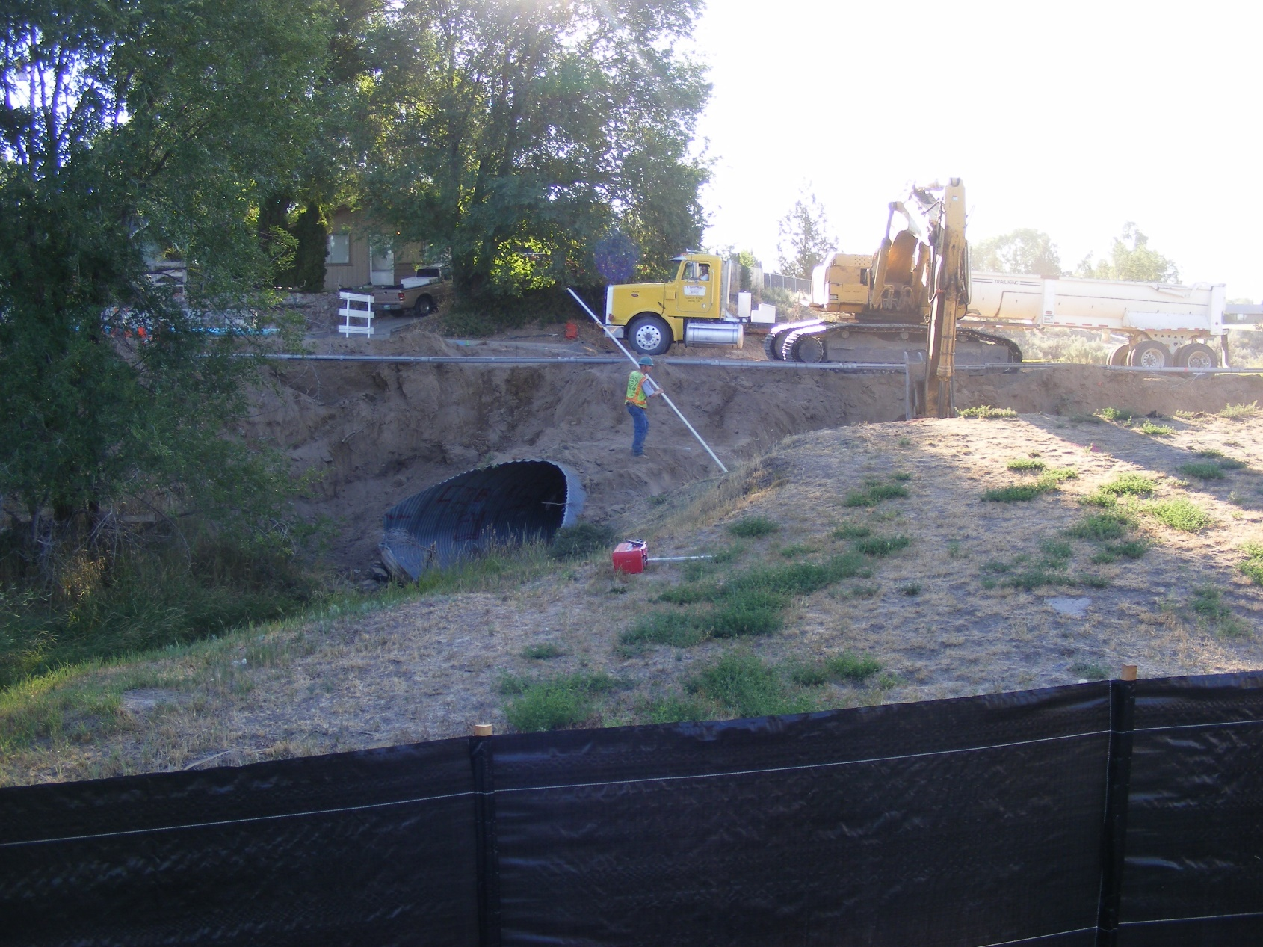

Slide 27
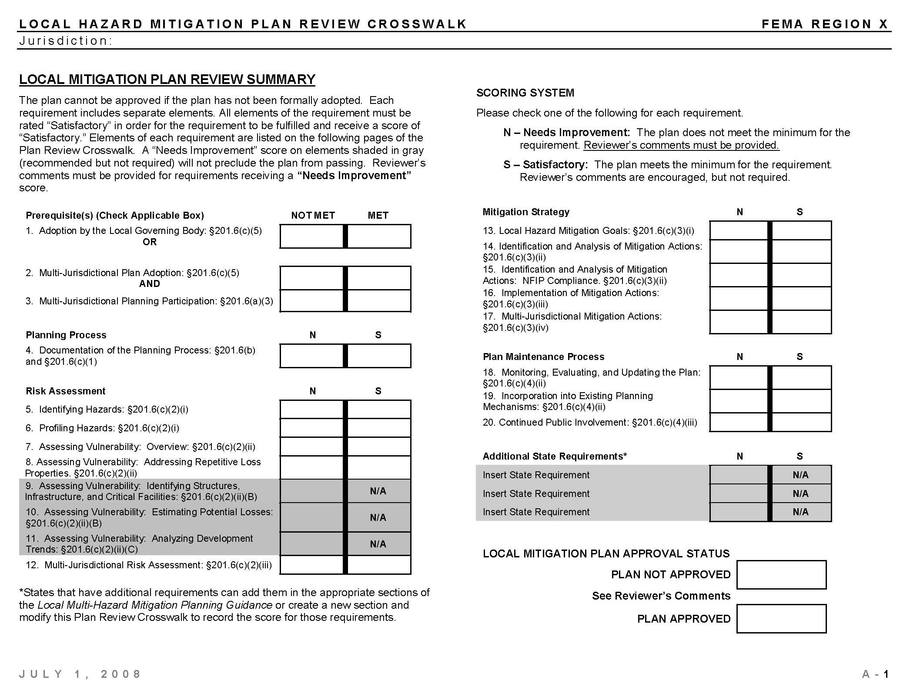
FEMA Crosswalk

Slide 28
Local plan mitigation review guide
Strong emphasis on Mitigation Strategy requirements;
Simplified guidance, only includes the regulatory requirements;
New Guiding Principles and Intent statements support regulatory requirements;
Plan Review Tool replaces the existing Crosswalk in a new format that is easier to use; and
Plan Review Tool communicates implementation of the plan as well as improvements to the plan.

